Slide 1
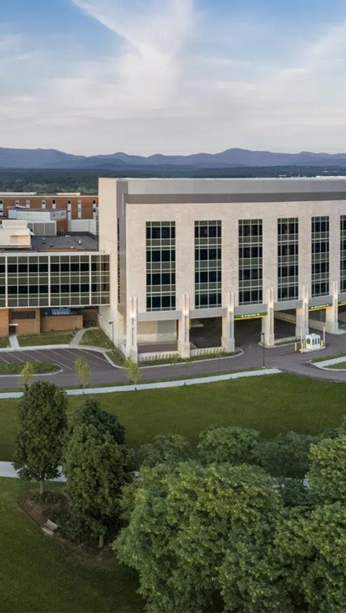
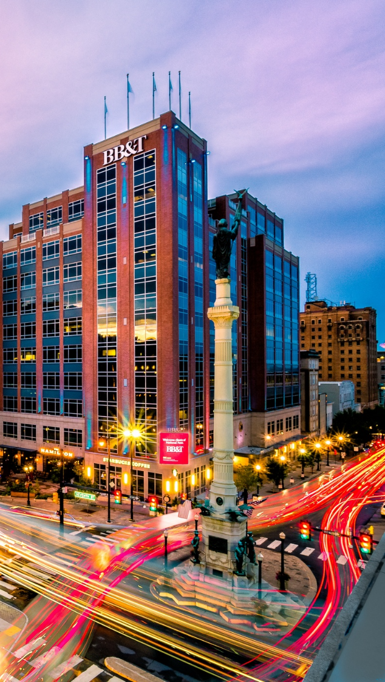

OPPORTUNITY REVIEW
DIRECT-TO-EMPLOYER GTM STRATEGY
Exploring a Possible DTE Health Plan for
The University of Vermont Health Network

Slide 2
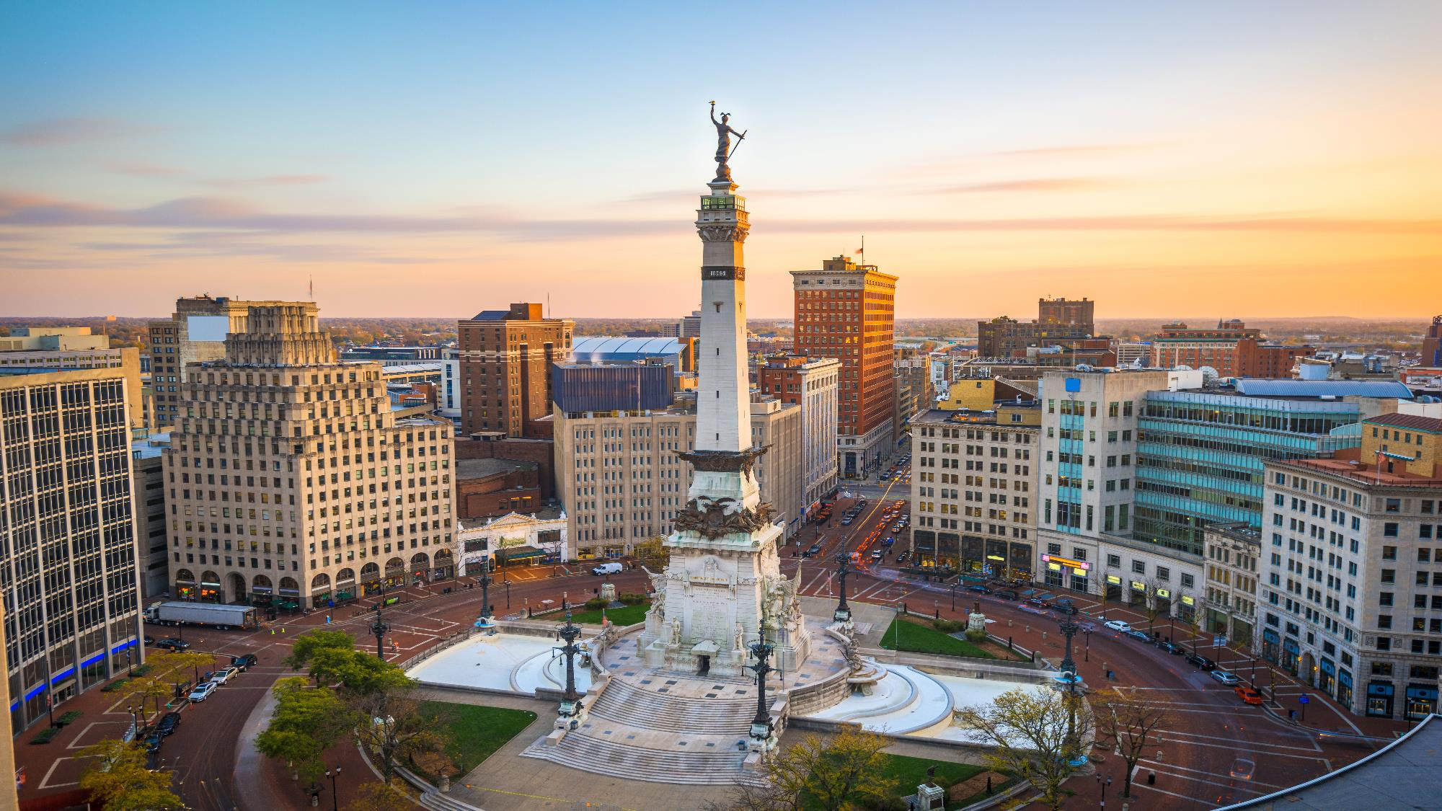

Founded in 1979, headquartered in Indianapolis
Largest Independently-Owned Full-Service Third-Party Administrator
Specialize in Administration of Self-Funded Plans and Population Health Management​
Leader in the Direct-to-Employer Movement
We Know and Understand the Market
Experience Working with All Professional Teams: Agents, Networks, MGAs
The Key Family of Companies is a Vertically Integrated group of benefit related organizations
3,000+ Corporate Clients
3 Million Members under Management
700 Employees

Slide 3


MARKET LEADER
IN
PRIVATE LABELED
DTE PLANS
Louisville, KY
Cincinnati, OH
Bentonville, AR
Knoxville, TN
Meridian, MS
Fort Myers, FL

Slide 4


DIRECT-TO-EMPLOYER (DTE)
YOU Pick the Name of the Health Plan
YOU Determine the Fees Charged
YOU Practice the Medicine
YOU Receive the Profits
WE Make it Successful
Your Health Plan Focused on a Direct Relationship with Self-Funded Employers in Your Market

Slide 5
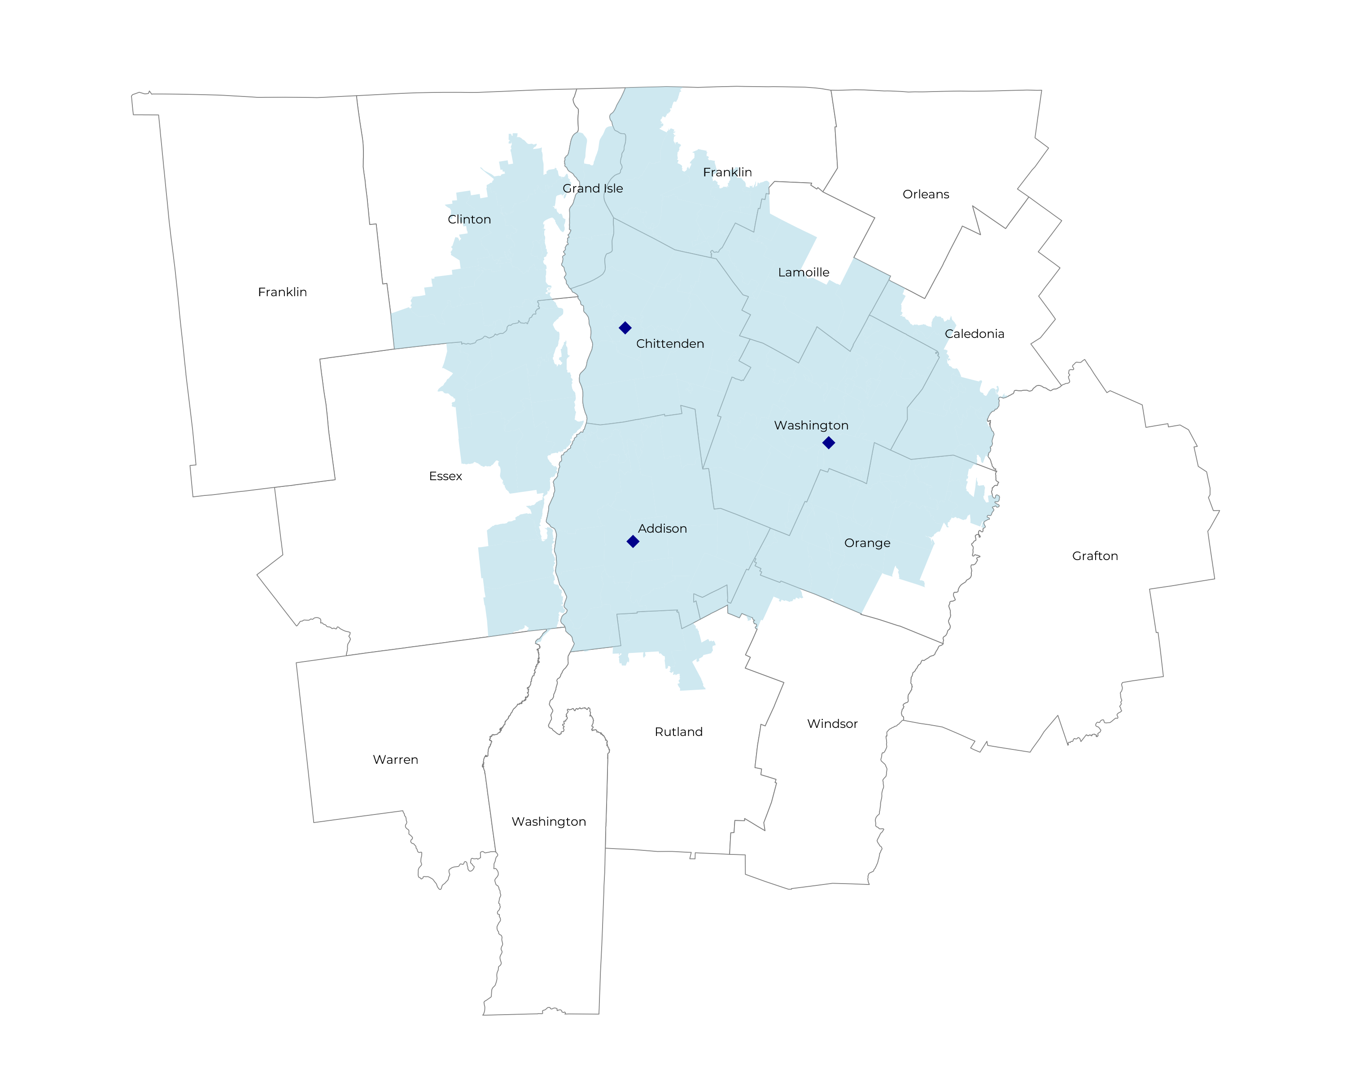
SIGNIFICANT OPPORTUNITY FOR PLAN GROWTH Researched for the below highlighted service area
Target Market 700+ Employers 100,000+ Employees 190,000+ Members
 | Employer Size Group (# of Employees)
Commercial Employers With Headquarters | 50-100 | 101-200 | 201-400 | 401-1,000 | 1,001-3,000 | 3,000+
In Catchment Area | 386 | 195 | 93 | 47 | 11 | 2
Total Employees at Employers | 50-100 | 101-200 | 201-400 | 401-1,000 | 1,001-3,000 | 3,000+
Headquartered in Catchment Area | 29,000 | 29,300 | 27,900 | 32,900 | 22,000 | 12,000
Total Members with Employers | 50-100 | 101-200 | 201-400 | 401-1,000 | 1,001-3,000 | 3,000+
Headquartered in Catchment Area | 52,200 | 52,700 | 50,200 | 59,200 | 39,600 | 21,600

Slide 6
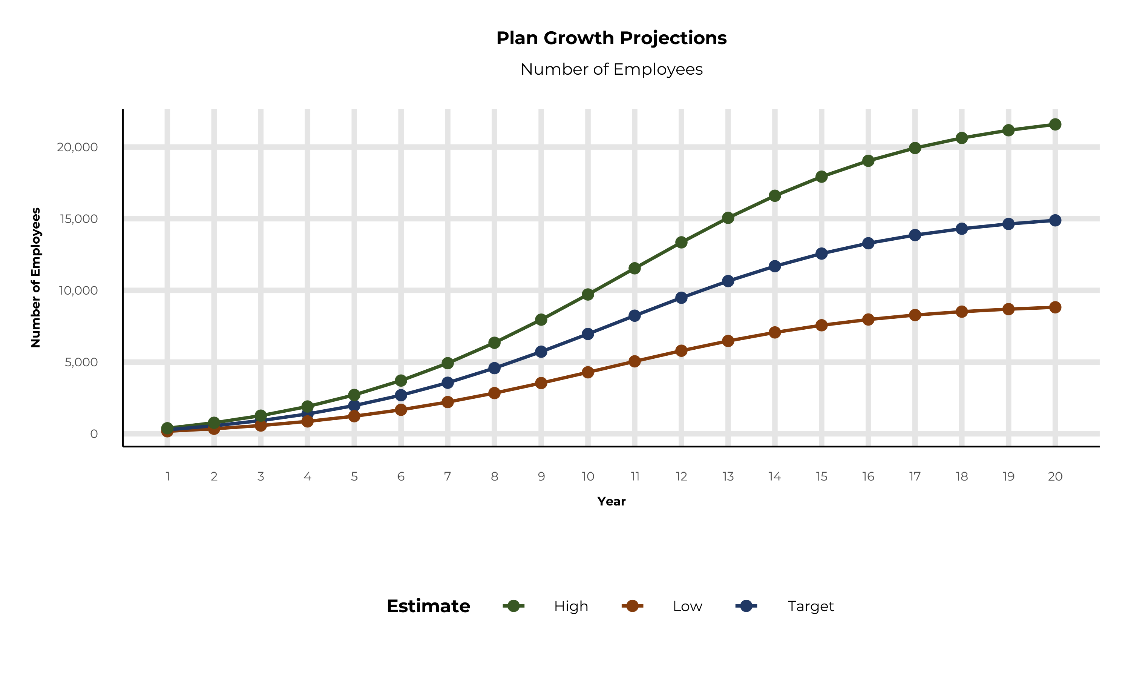
PLAN POTENTIAL GROWTH PATHS
Self Funded
102K
Insured
192K
Working Age
262K
Population
431K
Estimates includes the The University of Vermont Health Network service area in Clinton, Essex, Addison, Caledonia, Chittenden, Franklin, Grand Isle, Lamoille, Orange, Rutland, Washington, and Windsor Counties

Slide 7
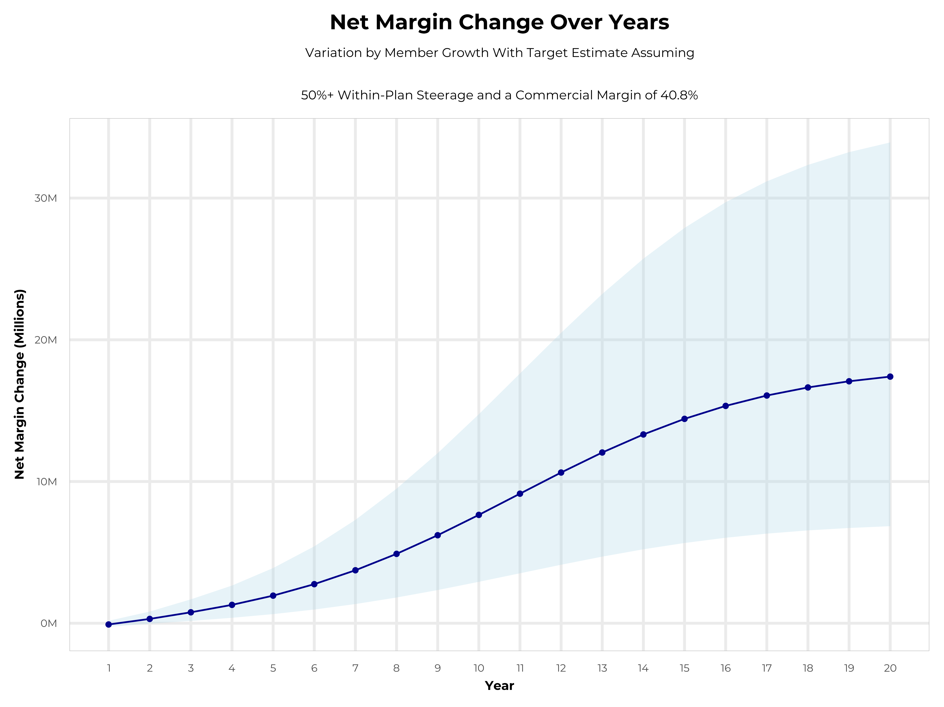
GROWING POWERFUL, LASTING PROFITABILITY
Early Stage
Gaining Name Recognition, Early Growth
New Revenue:
New Profit:
$3.28M
$1.17M
Growth Stage
Strong Reputation, Strong Growth
New Revenue:
New Profit:
$19.05M
$7.76M
Mature Stage
High Profitability, Market Saturation
New Revenue:
New Profit:
$38.25M
$15.75M

Slide 8
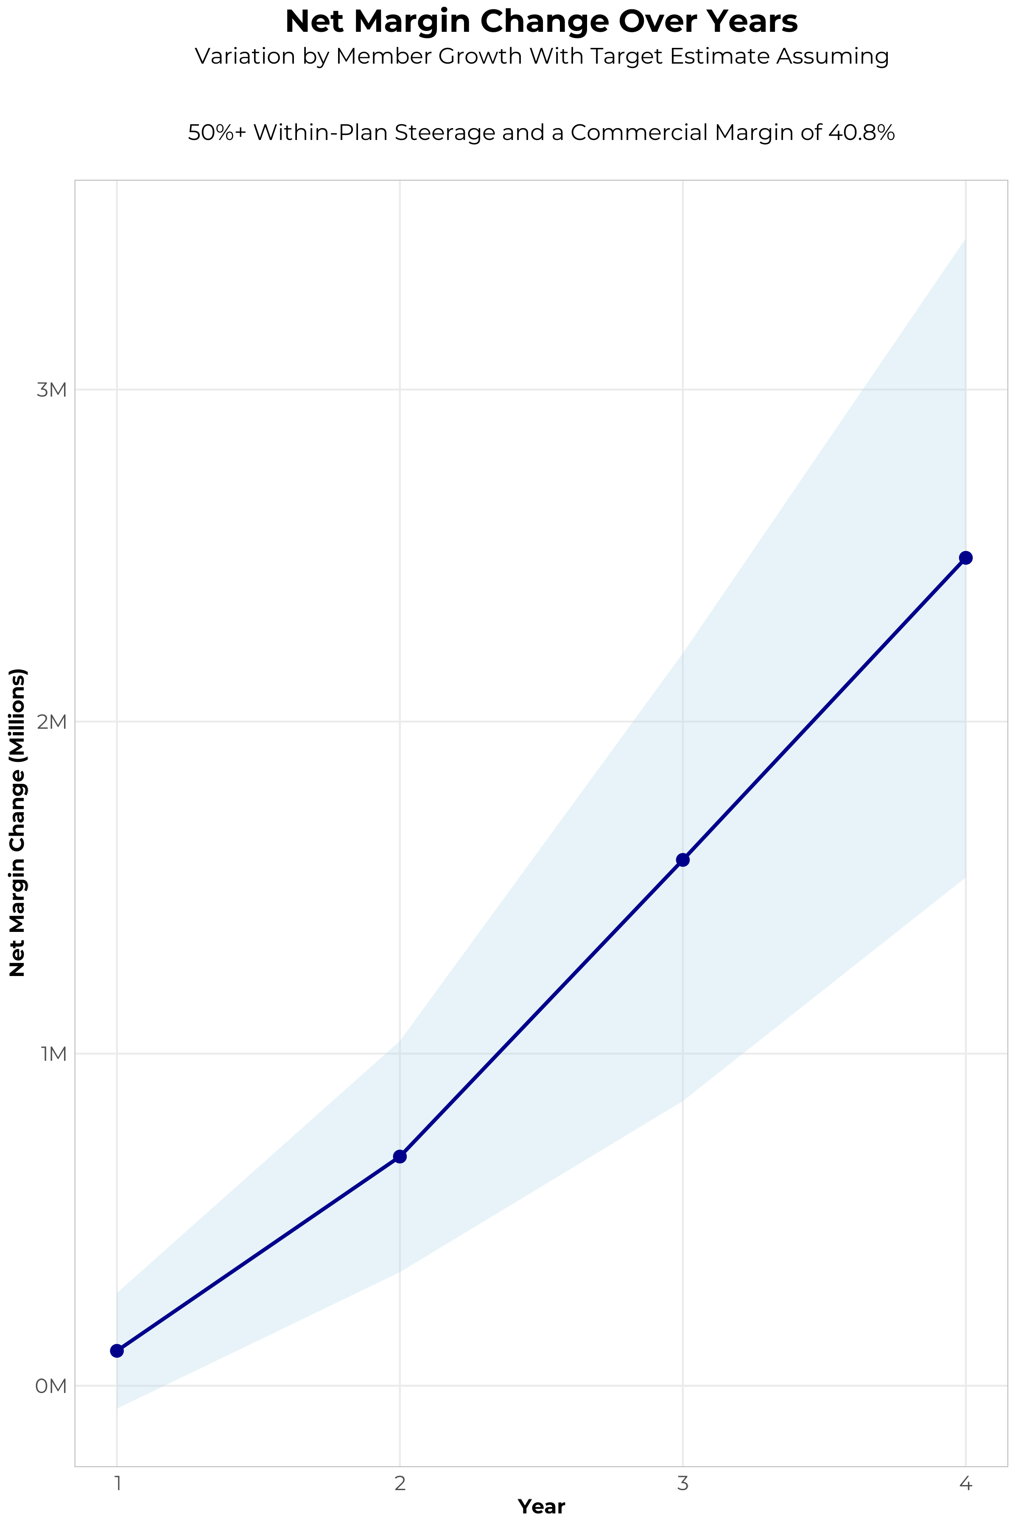
FOUR-YEAR PROJECTIONS
Target Member Growth | Target Member Growth | Target Member Growth | Target Member Growth | Target Member Growth
Metric | Year 1 | Year 2 | Year 3 | Year 4
Number of Members | 500 | 1,000 | 1,700 | 2,500
Incremental Margin | 429.1K | 858.1K | 1,743.1K | 2,643.2K
Network Access Fee | 6.0K | 12.0K | 20.4K | 30.0K
Implementation Fee (One-Time) | -150.0K | 0.0K | 0.0K | 0.0K
Sales and Marketing Costs | -180.0K | -180.0K | -180.0K | -180.0K
Net Margin Change | 105.1K | 690.1K | 1,583.5K | 2,493.2K
High Member Growth | High Member Growth | High Member Growth | High Member Growth | High Member Growth
Metric | Year 1 | Year 2 | Year 3 | Year 4
Number of Members | 700 | 1,400 | 2,300 | 3,400
Incremental Margin | 600.7K | 1,201.4K | 2,358.3K | 3,594.8K
Network Access Fee | 8.4K | 16.8K | 27.6K | 40.8K
Implementation Fee (One-Time) | -150.0K | 0.0K | 0.0K | 0.0K
Sales and Marketing Costs | -180.0K | -180.0K | -180.0K | -180.0K
Net Margin Change | 279.1K | 1,038.2K | 2,205.9K | 3,455.6K
Low Member Growth | Low Member Growth | Low Member Growth | Low Member Growth | Low Member Growth
Metric | Year 1 | Year 2 | Year 3 | Year 4
Number of Members | 300 | 600 | 1,000 | 1,600
Incremental Margin | 257.4K | 514.9K | 1,025.4K | 1,691.7K
Network Access Fee | 3.6K | 7.2K | 12.0K | 19.2K
Implementation Fee (One-Time) | -150.0K | 0.0K | 0.0K | 0.0K
Sales and Marketing Costs | -180.0K | -180.0K | -180.0K | -180.0K
Net Margin Change | -69.0K | 342.1K | 857.4K | 1,530.9K

Slide 9

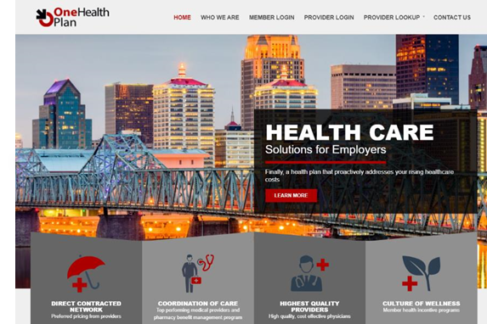
Complete Marketing System
Customized Branding and Messaging
Customized Brochures
Customized Web Site
Targeted Employer Outreach
Sales System (Social Media, Email, Text, etc.)

Slide 10
PROJECTED PLAN GROWTH
Year | Employees | Members | Percent of Members Choosing The University of Vermont Health Network for Inpatient Care | Percent of Members Choosing The University of Vermont Health Network for Outpatient Care
1 | 300 | 500 | 75% | 65%
2 | 600 | 1,100 | 75% | 65%
3 | 900 | 1,600 | 76% | 70%
4 | 1,400 | 2,500 | 76% | 71%
5 | 2,000 | 3,600 | 76% | 71%
6 | 2,700 | 4,900 | 76% | 72%
7 | 3,600 | 6,500 | 76% | 72%
8 | 4,600 | 8,300 | 76% | 72%
9 | 5,700 | 10,300 | 76% | 72%
10 | 7,000 | 12,600 | 76% | 72%
11 | 8,200 | 14,800 | 76% | 73%
12 | 9,500 | 17,100 | 76% | 73%
13 | 10,600 | 19,100 | 76% | 73%
14 | 11,700 | 21,100 | 76% | 73%
15 | 12,600 | 22,700 | 76% | 74%
16 | 13,300 | 23,900 | 77% | 74%
17 | 13,900 | 25,000 | 77% | 74%
18 | 14,300 | 25,700 | 77% | 74%
19 | 14,600 | 26,300 | 77% | 74%
20 | 14,900 | 26,800 | 77% | 74%
KBA currently estimates that The University of Vermont Health Network has 74% inpatient market share, and 39% outpatient market compared to hospitals/clinics in the The University of Vermont Health Network service area (see slide 8).
Based on previous DTE experience, KBA expects a significant bump in patient steerage to The University of Vermont Health Network.
Additional steerage will occur from additional steerage patient benefits and the patient convenience card.
High estimates start nearly 10% higher than target with low estimates at 10% lower than target

Slide 11

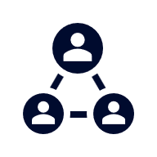



A PARTNER YOU CAN TRUST
OUR OBJECTIVES ARE ALIGNED
WE KNOW THE
MARKET
COMPLETELY TRANSPARENT
WE HAVE THE SOPHISTICATION AND INFRASTRUCTURE TO EFFECTIVELY COMPETE
Derek Moore, Senior Vice President – KBA
845-283-9973 * derek.moore@keybenefit.com

